Slide 1
AWS

Slide 2
Cloud Integration

Slide 3
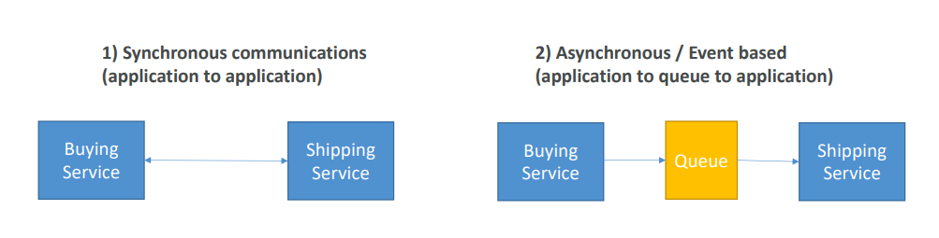
Introduction
• When we start deploying multiple applications, they will inevitably need
to communicate with one another
• There are two patterns of application communication

Slide 4
Introduction
• Synchronous between applications can be problematic if there are sudden spikes of traffic
• What if you need to suddenly encode 1000 videos but usually it’s 10?
• In that case, it’s better to decouple your applications:
• using SQS: queue model
• using SNS: pub/sub model
• using Kinesis: real-time data streaming model
• These services can scale independently from our application!

Slide 5
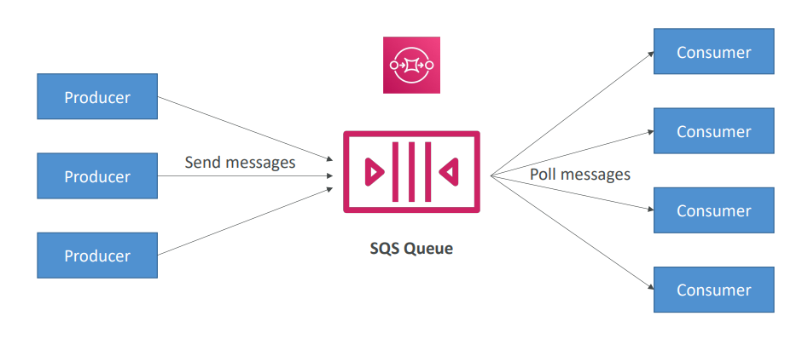
Amazon SQS – Simple Queue Service
What’s a queue?

Slide 6
Amazon SQS – Standard Queue
• Oldest AWS offering (over 10 years old)
• Fully managed service (~serverless), use to decouple applications
• Scales from 1 message per second to 10,000s per second
• Default retention of messages: 4 days, maximum of 14 days
• No limit to how many messages can be in the queue
• Messages are deleted after they’re read by consumers
• Low latency (<10 ms on publish and receive)
• Can have duplicate messages (at least once delivery, occasionally)
• Can have out of order messages (best effort ordering)

Slide 7
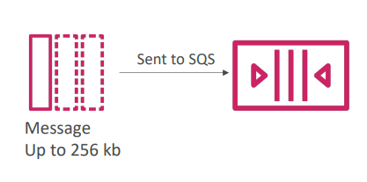
SQS – Producing Messages
• Produced to SQS using the SDK (SendMessage API)
• The message is persisted in SQS until a consumer deletes it
• Message retention: default 4 days, up to 14 days
• Example: send an order to be processed
Order id
Customer id
Any attributes you want
• SQS standard: unlimited throughput

Slide 8
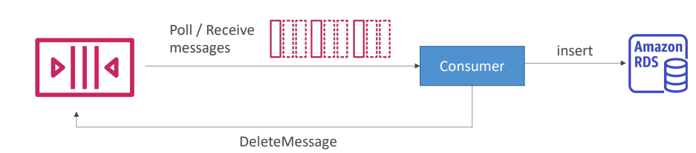
SQS – Consuming Messages
• Consumers (running on EC2 instances, servers, or AWS Lambda)…
• Poll SQS for messages (receive up to 10 messages at a time)
• Process the messages (example: insert the message into an RDS database)
• Delete the messages using the DeleteMessage API

Slide 9
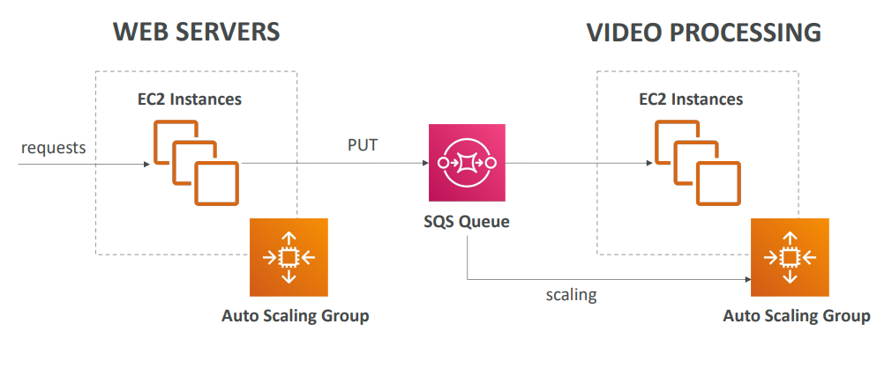
SQS to decouple between application tiers

Slide 10
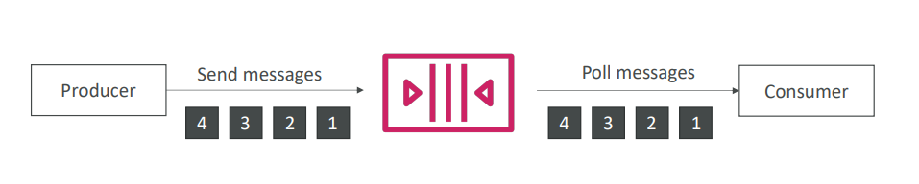
Amazon SQS – FIFO Queue
• FIFO = First In First Out (ordering of messages in the queue)
• Messages are processed in order by the consumer

Slide 11
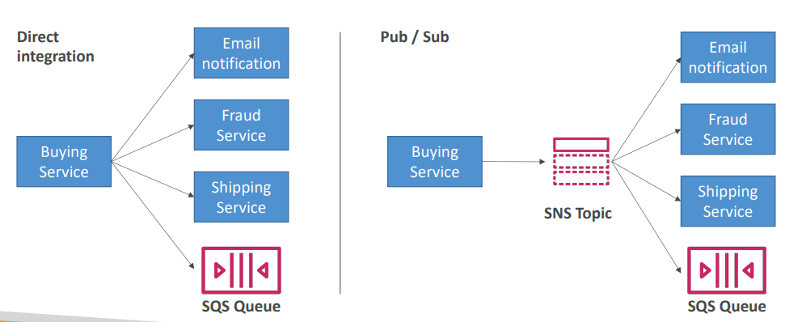
Amazon SNS
• What if you want to send one message to many receivers?

Slide 12
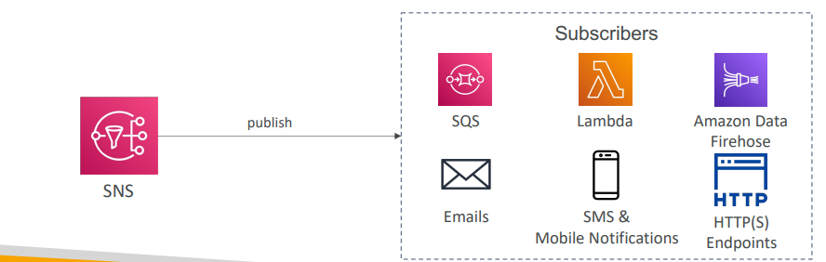
Amazon SNS
• The “event producer” only sends message to one SNS topic
• As many “event receiver( subscription)” as we want to listen to the SNS topic notifications
• Each subscriber to the topic will get all the messages
• Up to 12,500,000 subscriptions per topic, 100,000 topics limit

Slide 13
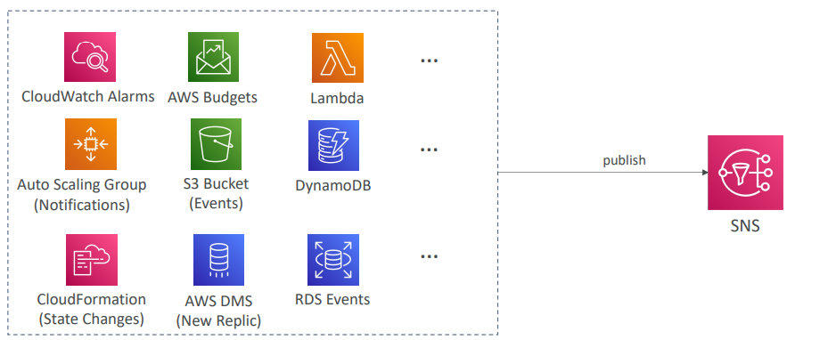
SNS integrates with a lot of AWS services
• Many AWS services can send data directly to SNS for notifications

Slide 14
Amazon SNS – How to publish
Topic Publish (using the SDK)
Create a topic
Create a subscription (or many)
Publish to the topic
Direct Publish (for mobile apps SDK)
Create a platform application
Create a platform endpoint
Publish to the platform endpoint
Works with Google GCM, Apple APNS, Amazon ADM…

Slide 15
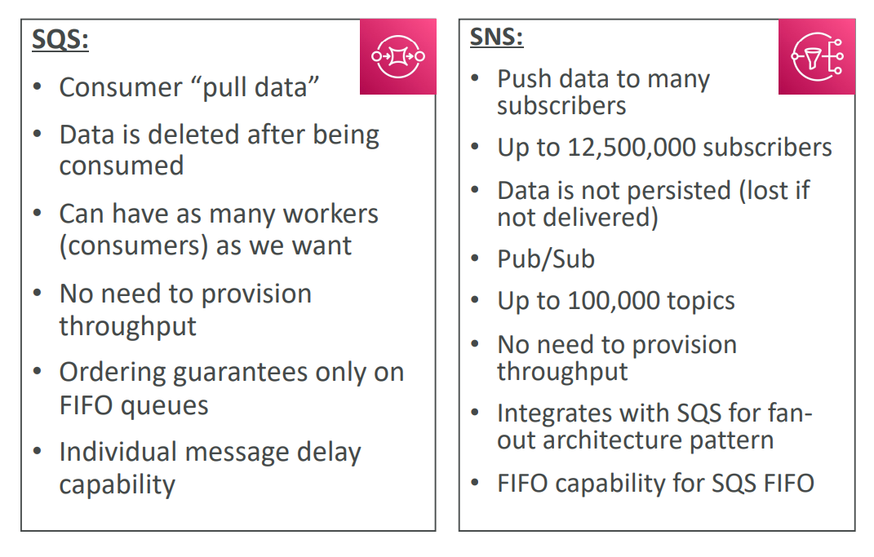
SQS vs SNS

Slide 16
Integration Section – Summary
• SQS:
Queue service in AWS
Multiple Producers, messages are kept up to 14 days
Multiple Consumers share the read and delete messages when done
Used to decouple applications in AWS
• SNS:
Notification service in AWS
Subscribers: Email, Lambda, SQS, HTTP, Mobile…
Multiple Subscribers, send all messages to all of them
No message retention

